Slide 1

Automated treasure hunting car
D&B Group 33
2023-10-11

Slide 2

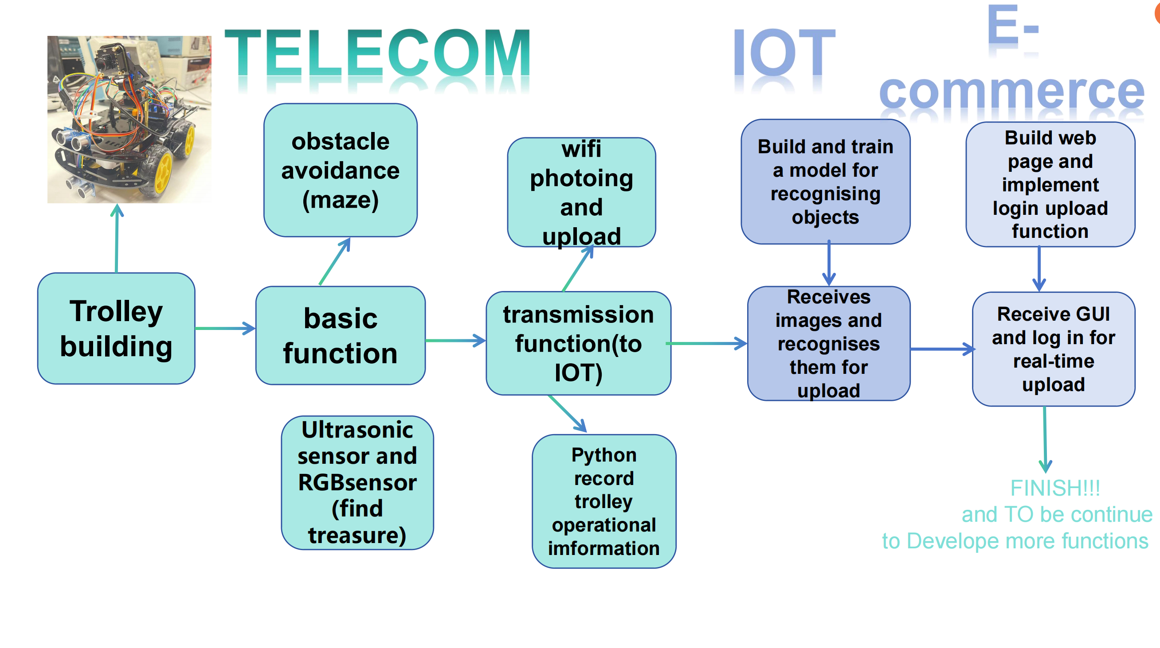
flow chart

Slide 3
Introduction
This project design and build a car based on Arduino, which can realize autonomous driving, remote control control, obstacle avoidance and other functions.
Through this project, we learned a lot about electronic design and programming, learned to use Arduino electronic platform 3D Max and other related software, and improved our practical abilities and innovative thinking.

Slide 4
Index
Hardware Model and Control Software
Object Detection Software
Database Management and Web Visualization
Demonstration
Group members

Slide 5
01
Hardware Model and Control Software

Slide 6
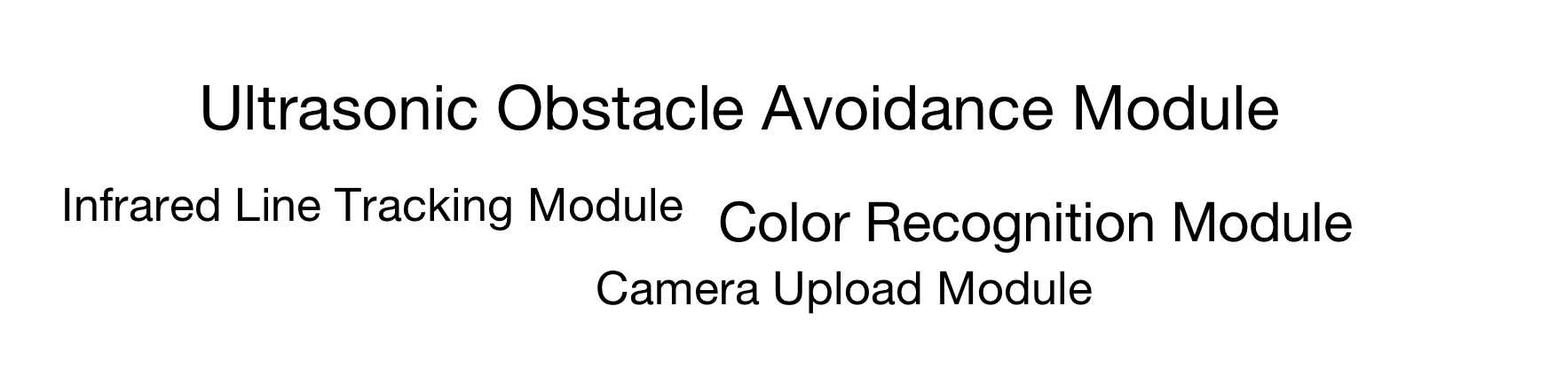
Modules with different functions
Notes:
consists of several modules with different functions

Slide 7
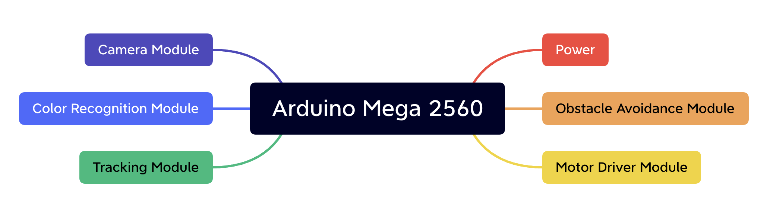
Arduino board
Taking the Arduino Mega 2560 development board as the core control unit, it has rich I/O interfaces and powerful programming capabilities

Slide 8

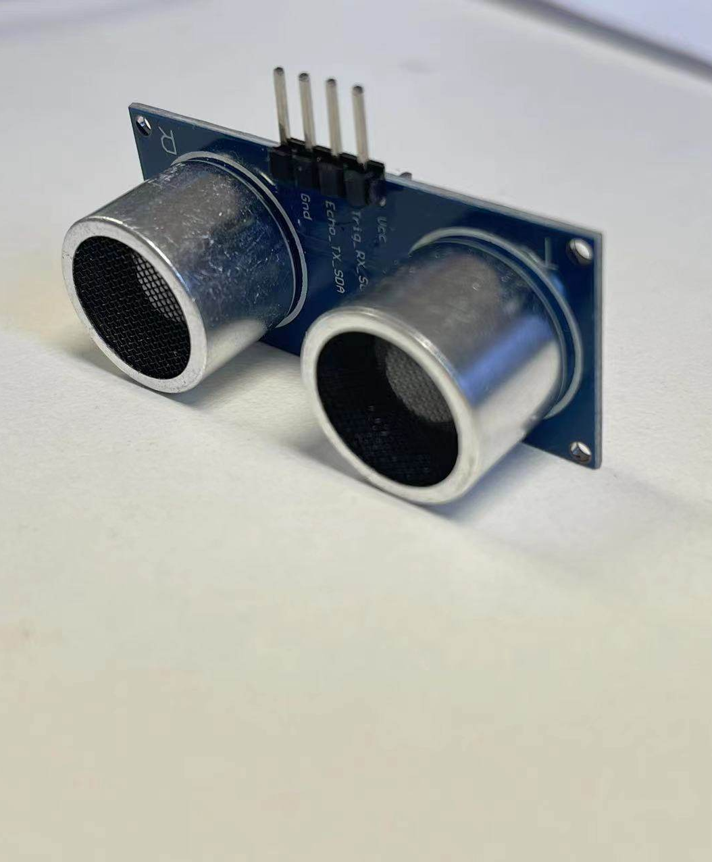
Ultrasonic obstacle avoidance module
Ultrasonic sensor module is a sensor module commonly used in intelligent robots, unmanned vehicles and automation systems
We use this to detect obstacles ahead and navigate the maze

Slide 9
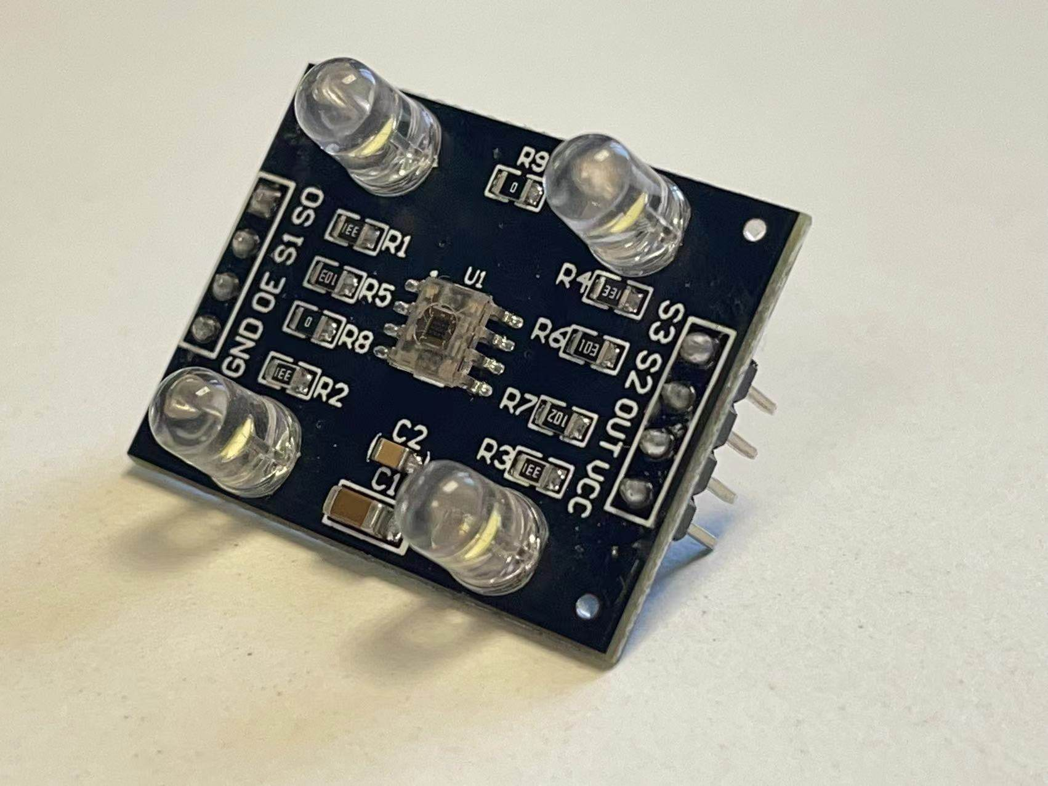
Color sensor module
The color sensor module is able to detect and identify the color of an object and convert it into a corresponding electrical signal
We tried to use it to detect treasures
but its accuracy was too low and was abandoned.

Slide 10
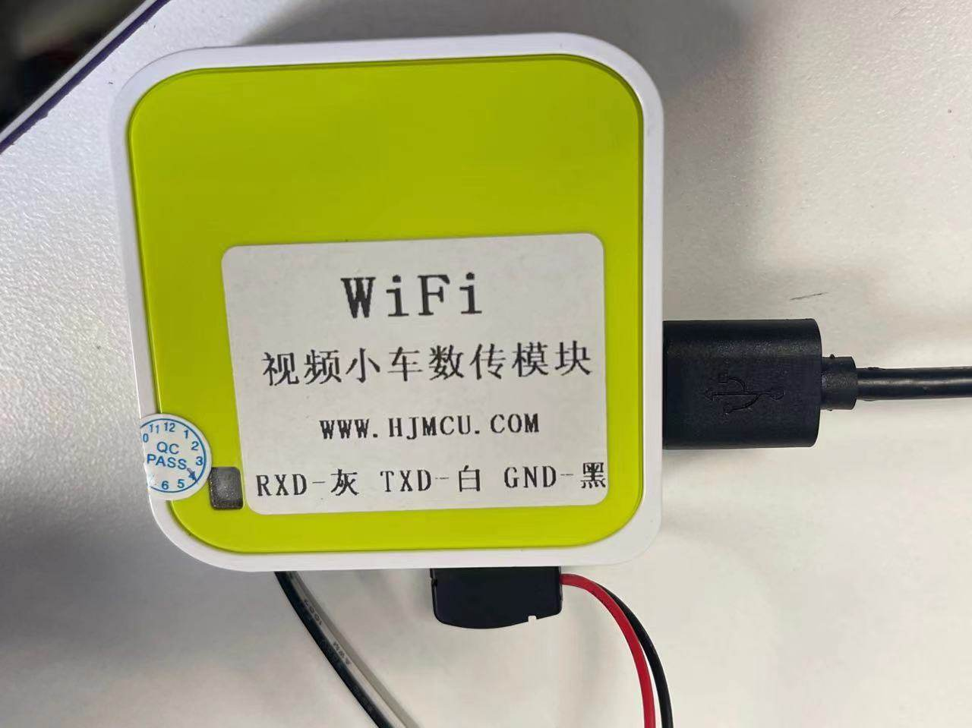
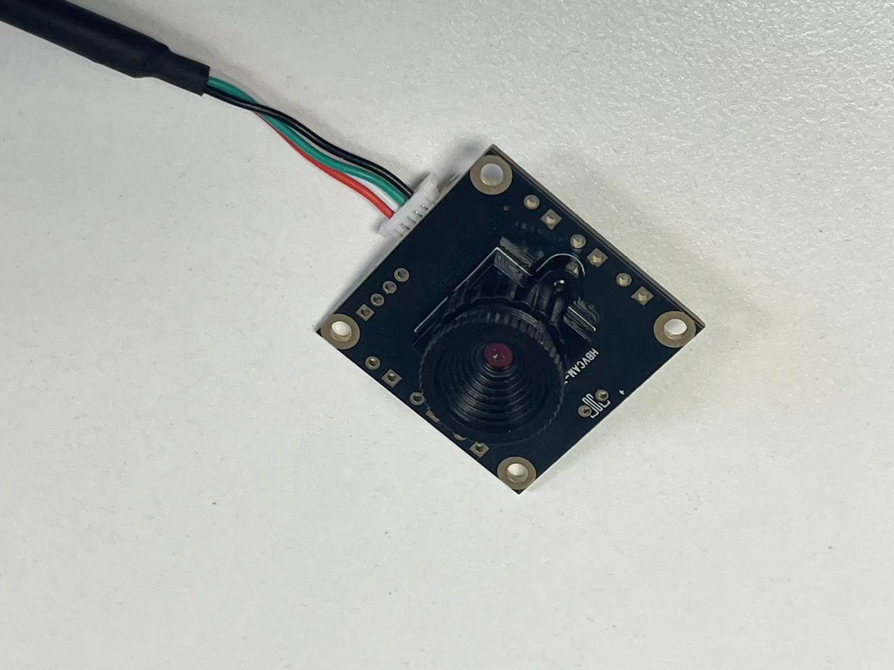
Photo module
WI-FI transmission The photo upload module that combines the WiFi data transmission module . camera is a device that integrates WiFi communication and camera functions. It can take photos and upload the photos to a designated server or cloud through the WiFi network.

Slide 11
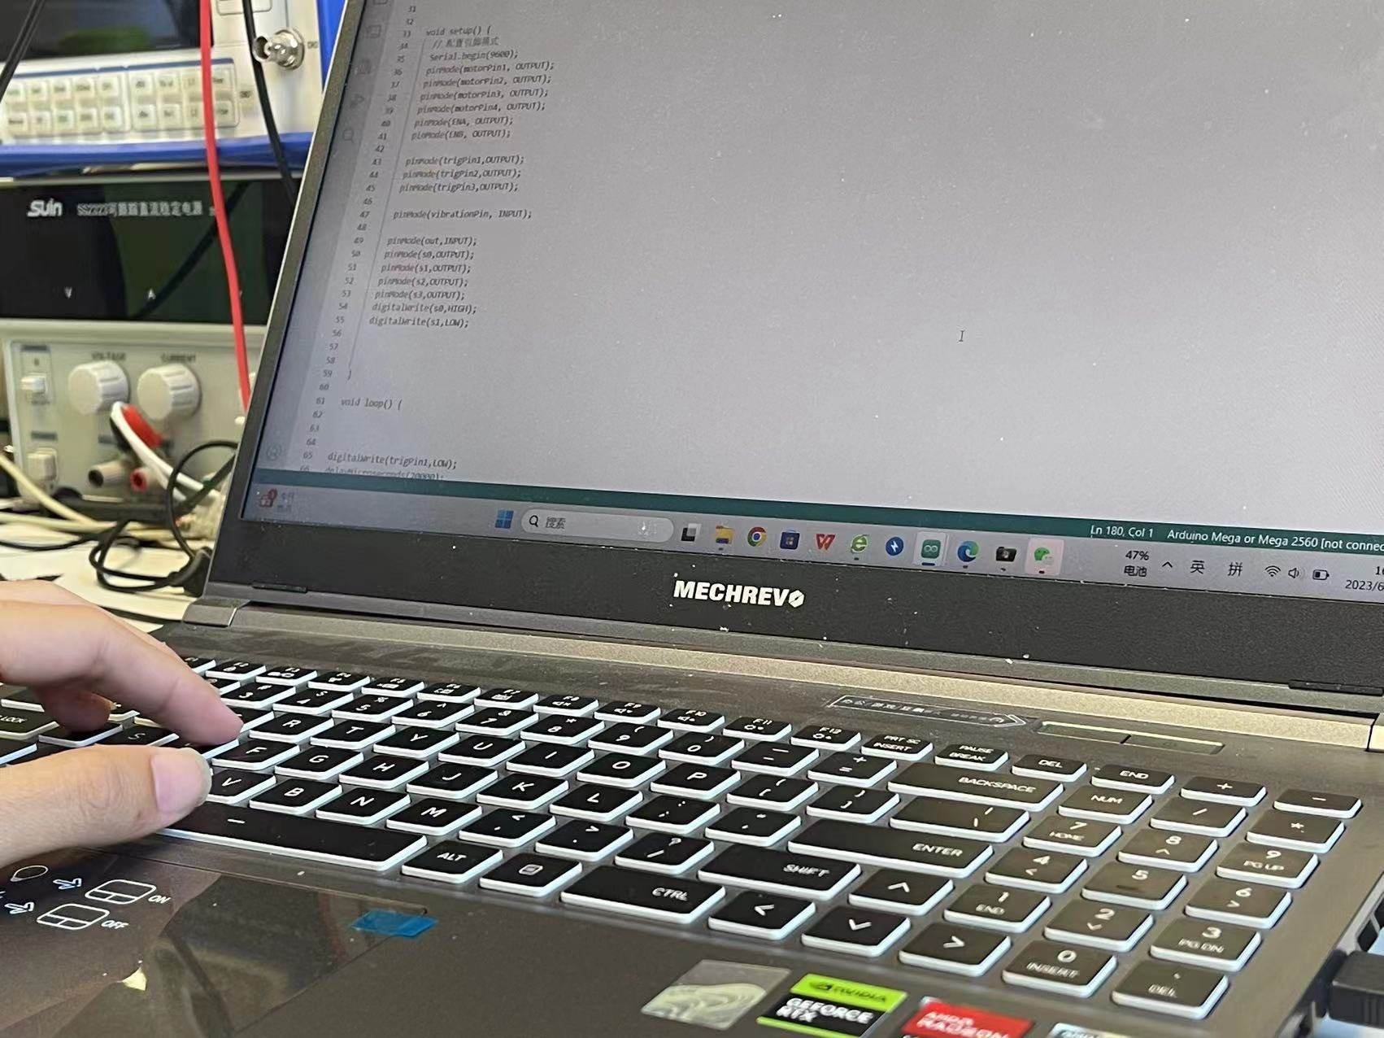
Technical solutions and development process
Technical solutions In order to realize the autonomous navigation, remote control and obstacle avoidance functions of the car, we used the Arduino programming language for software development.

Slide 12
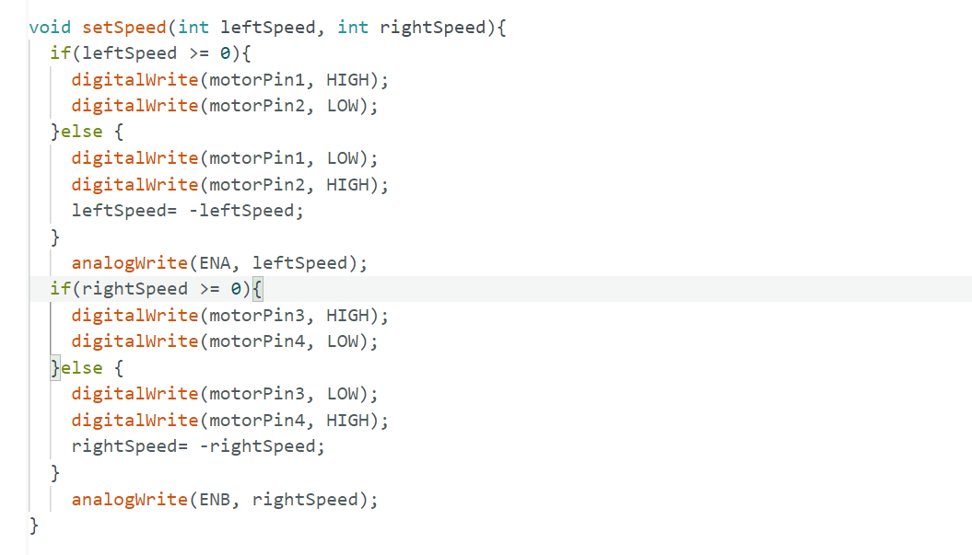
Code
Motor drive module

Slide 13
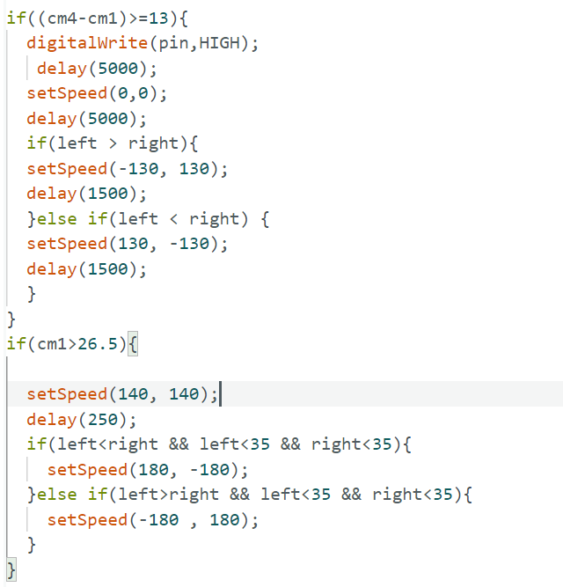
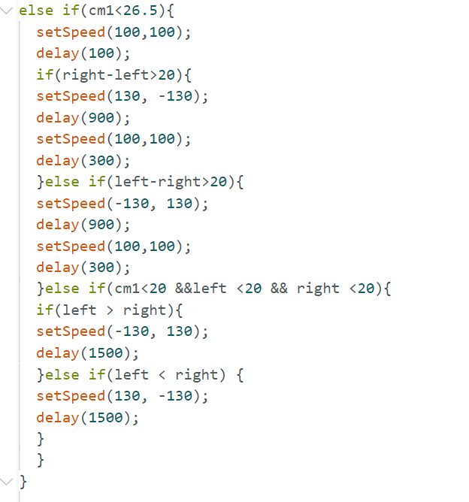
Code
Ultrasonic obstacle avoidance module

Slide 14
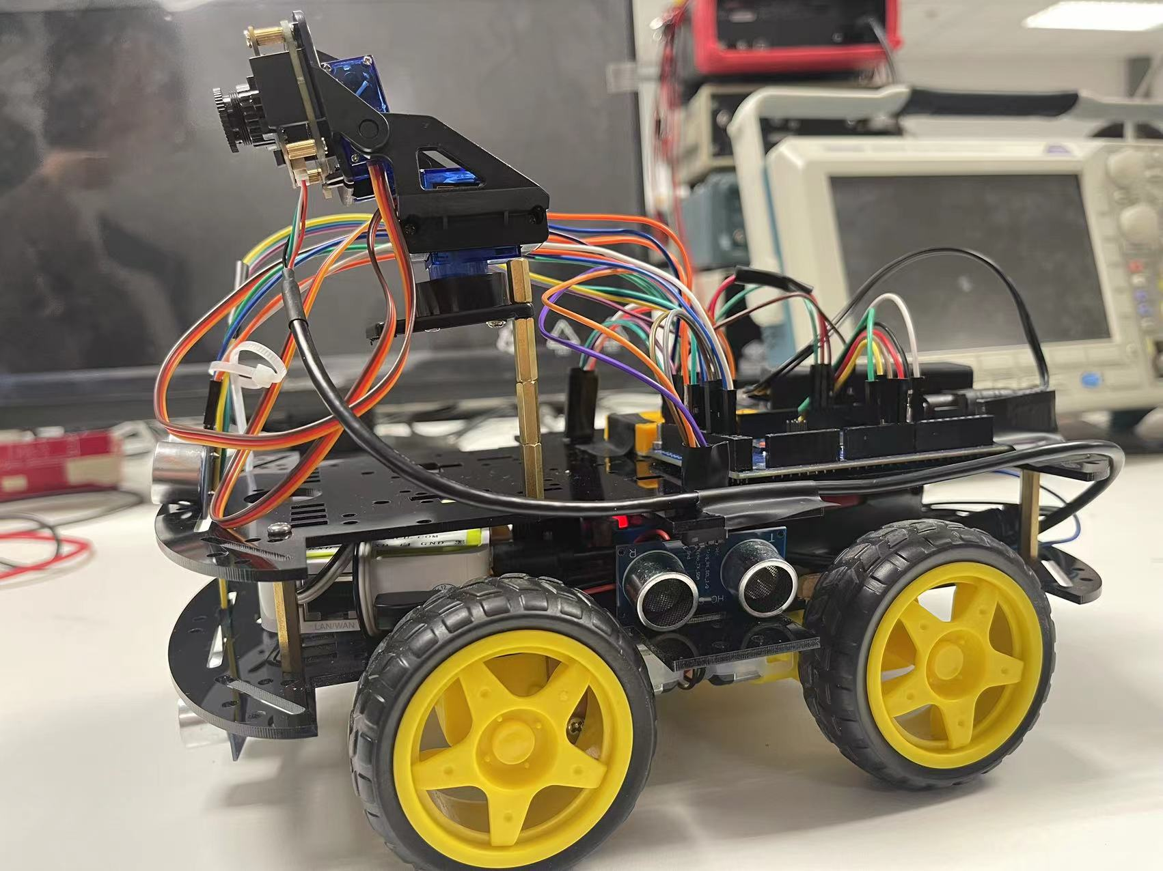
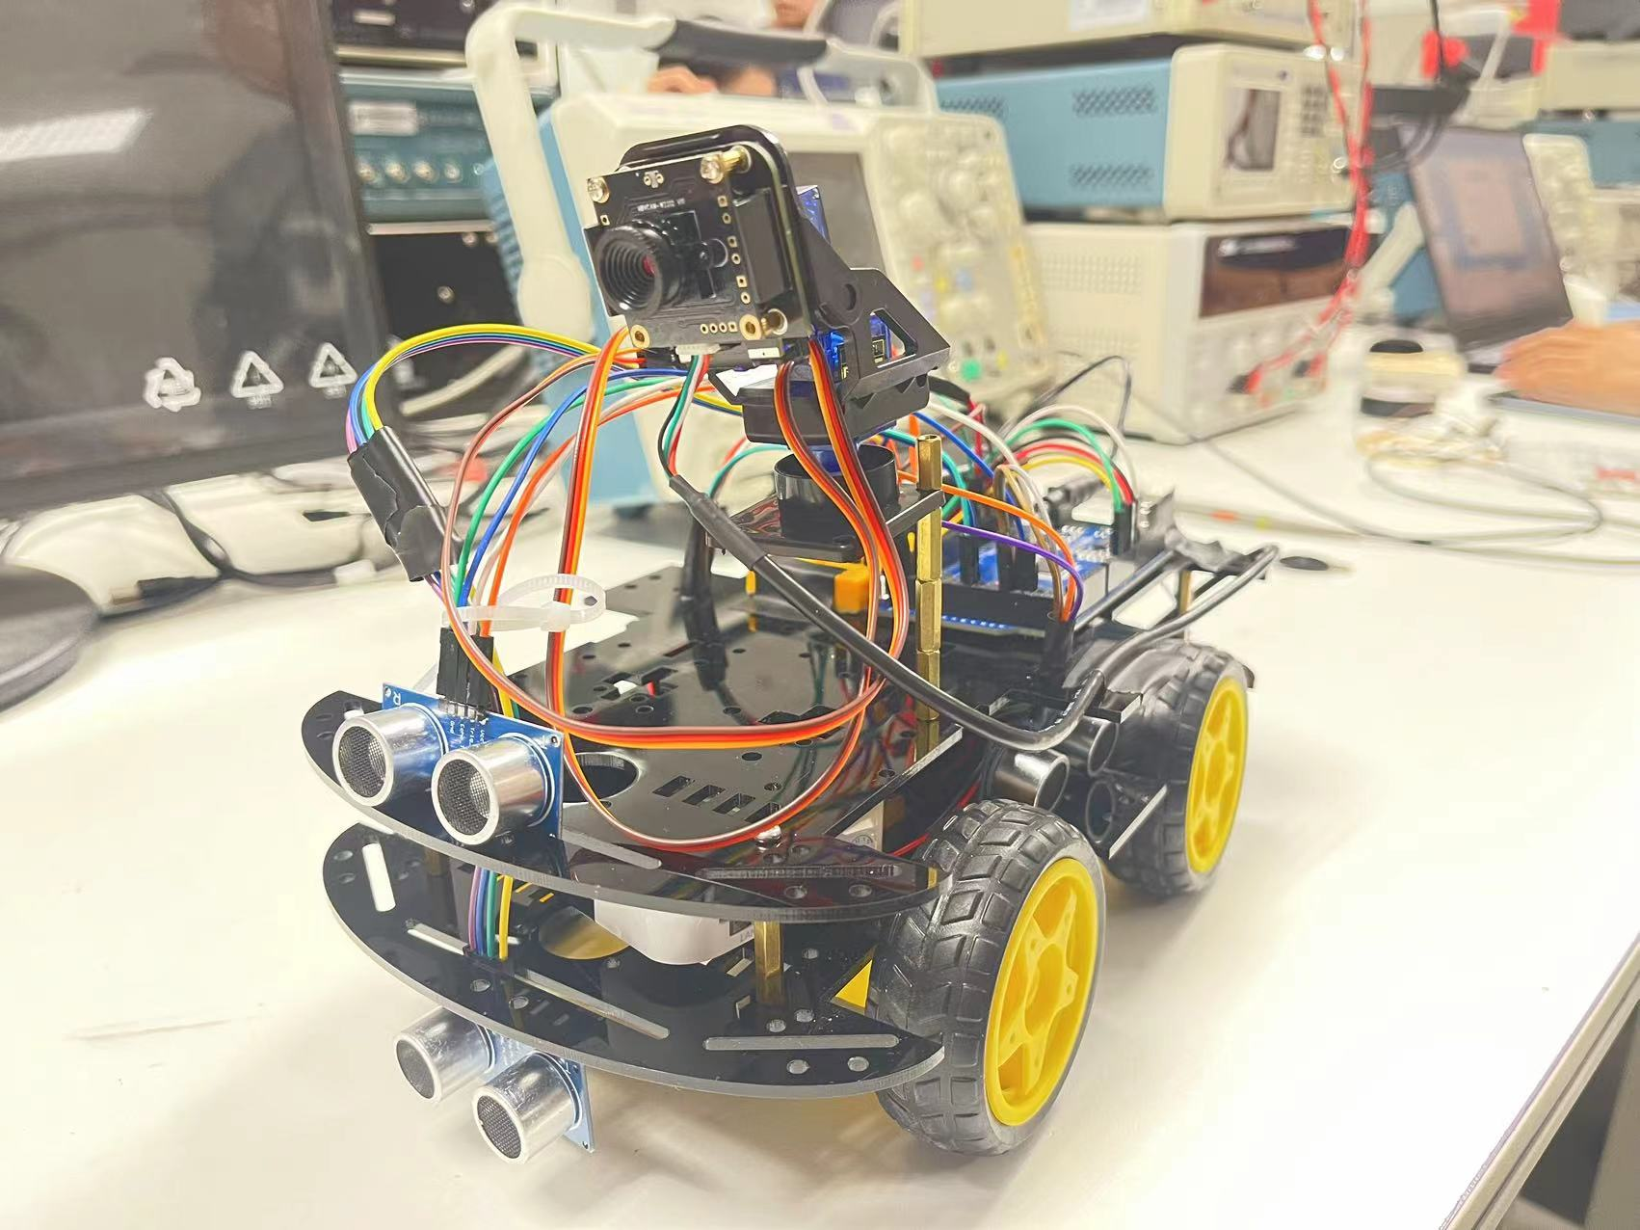
Appearance

Slide 15
02
Object Detection Software

Slide 16
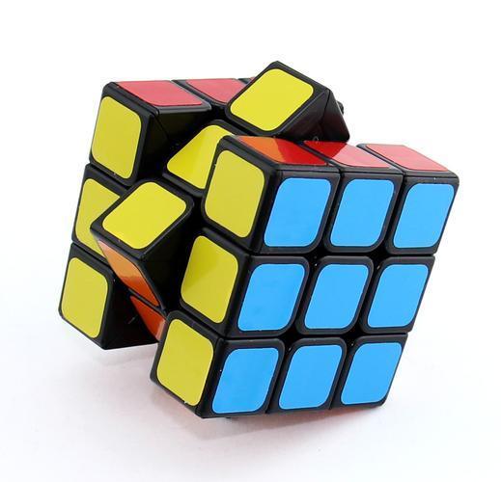
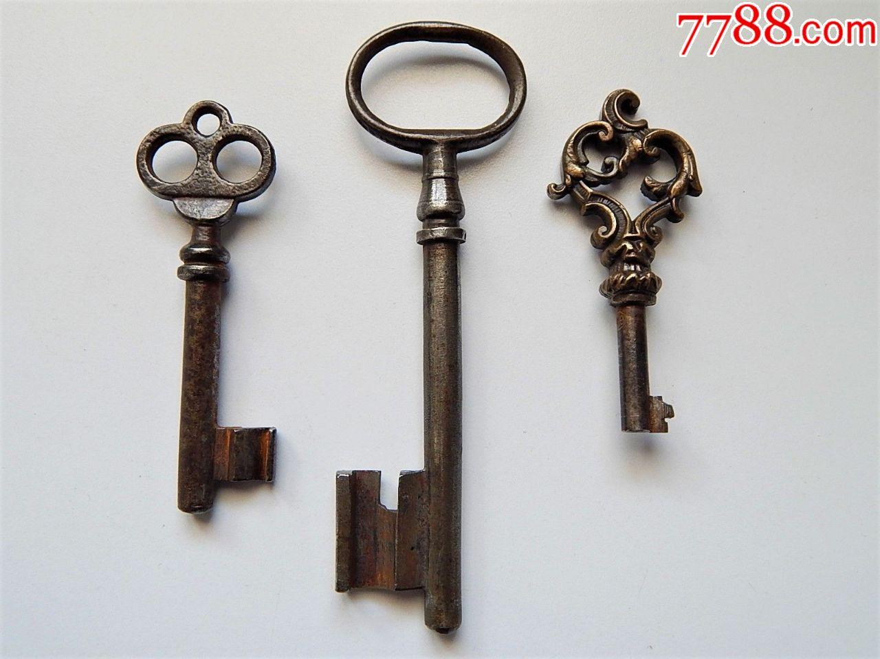

Treasures

Slide 17
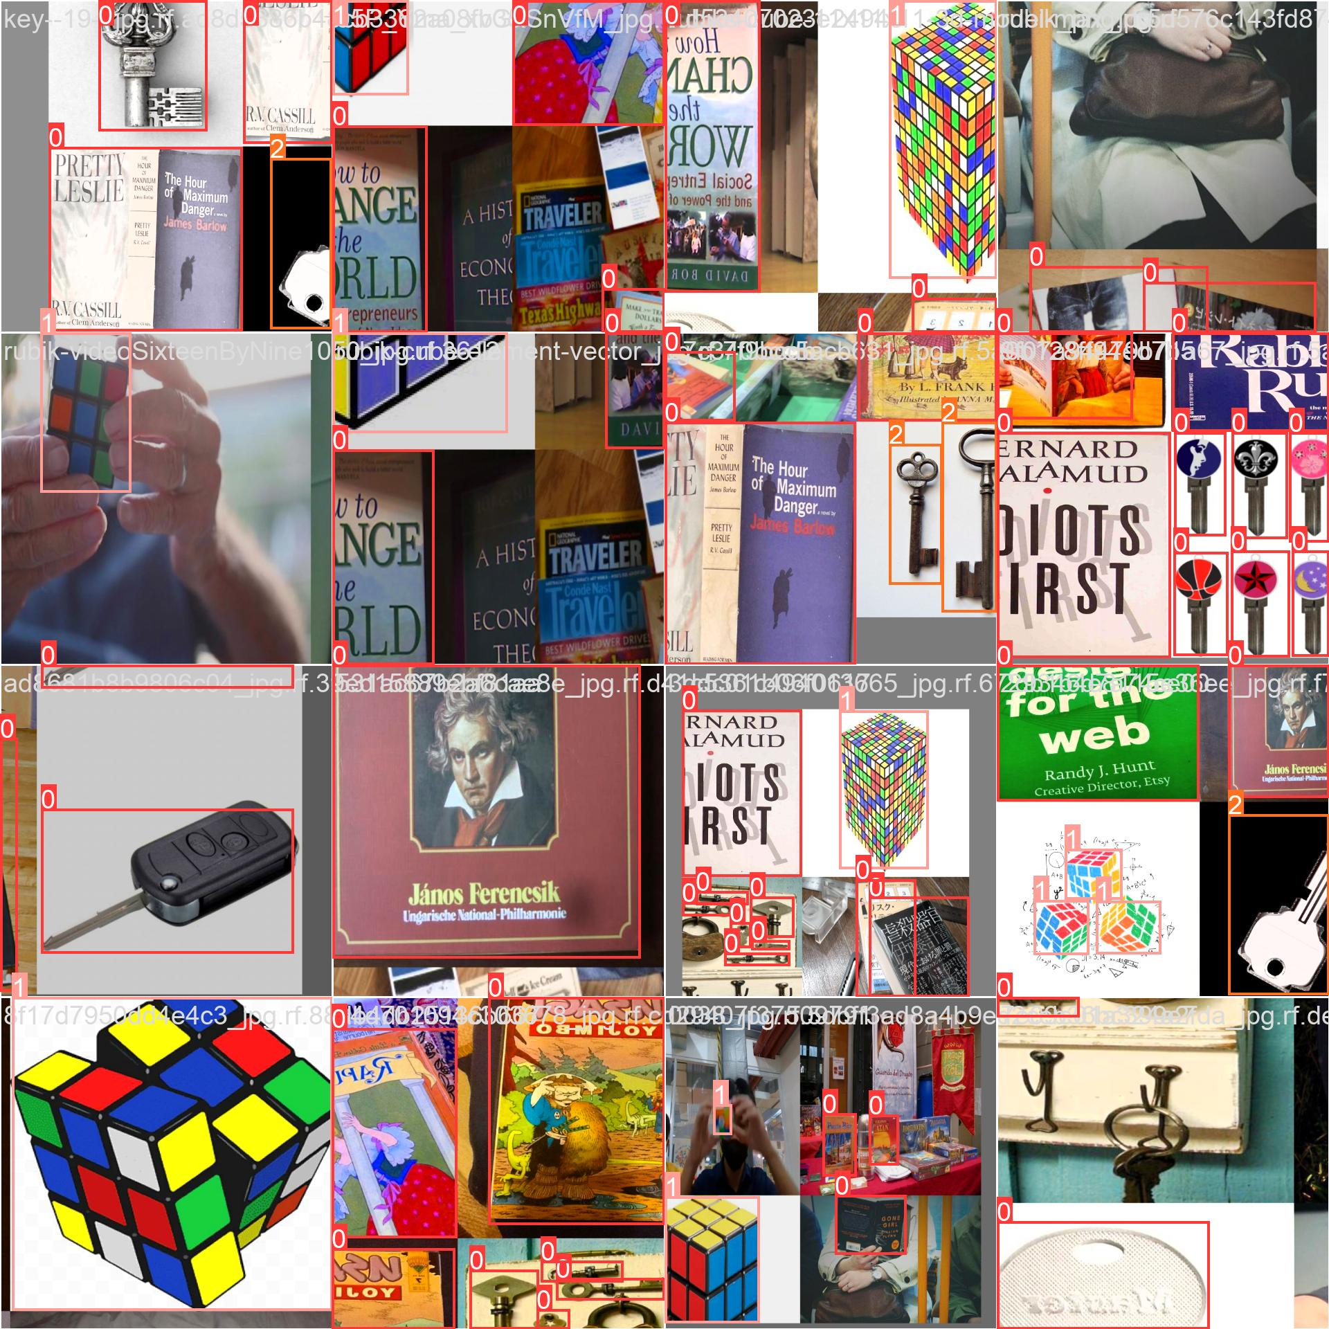
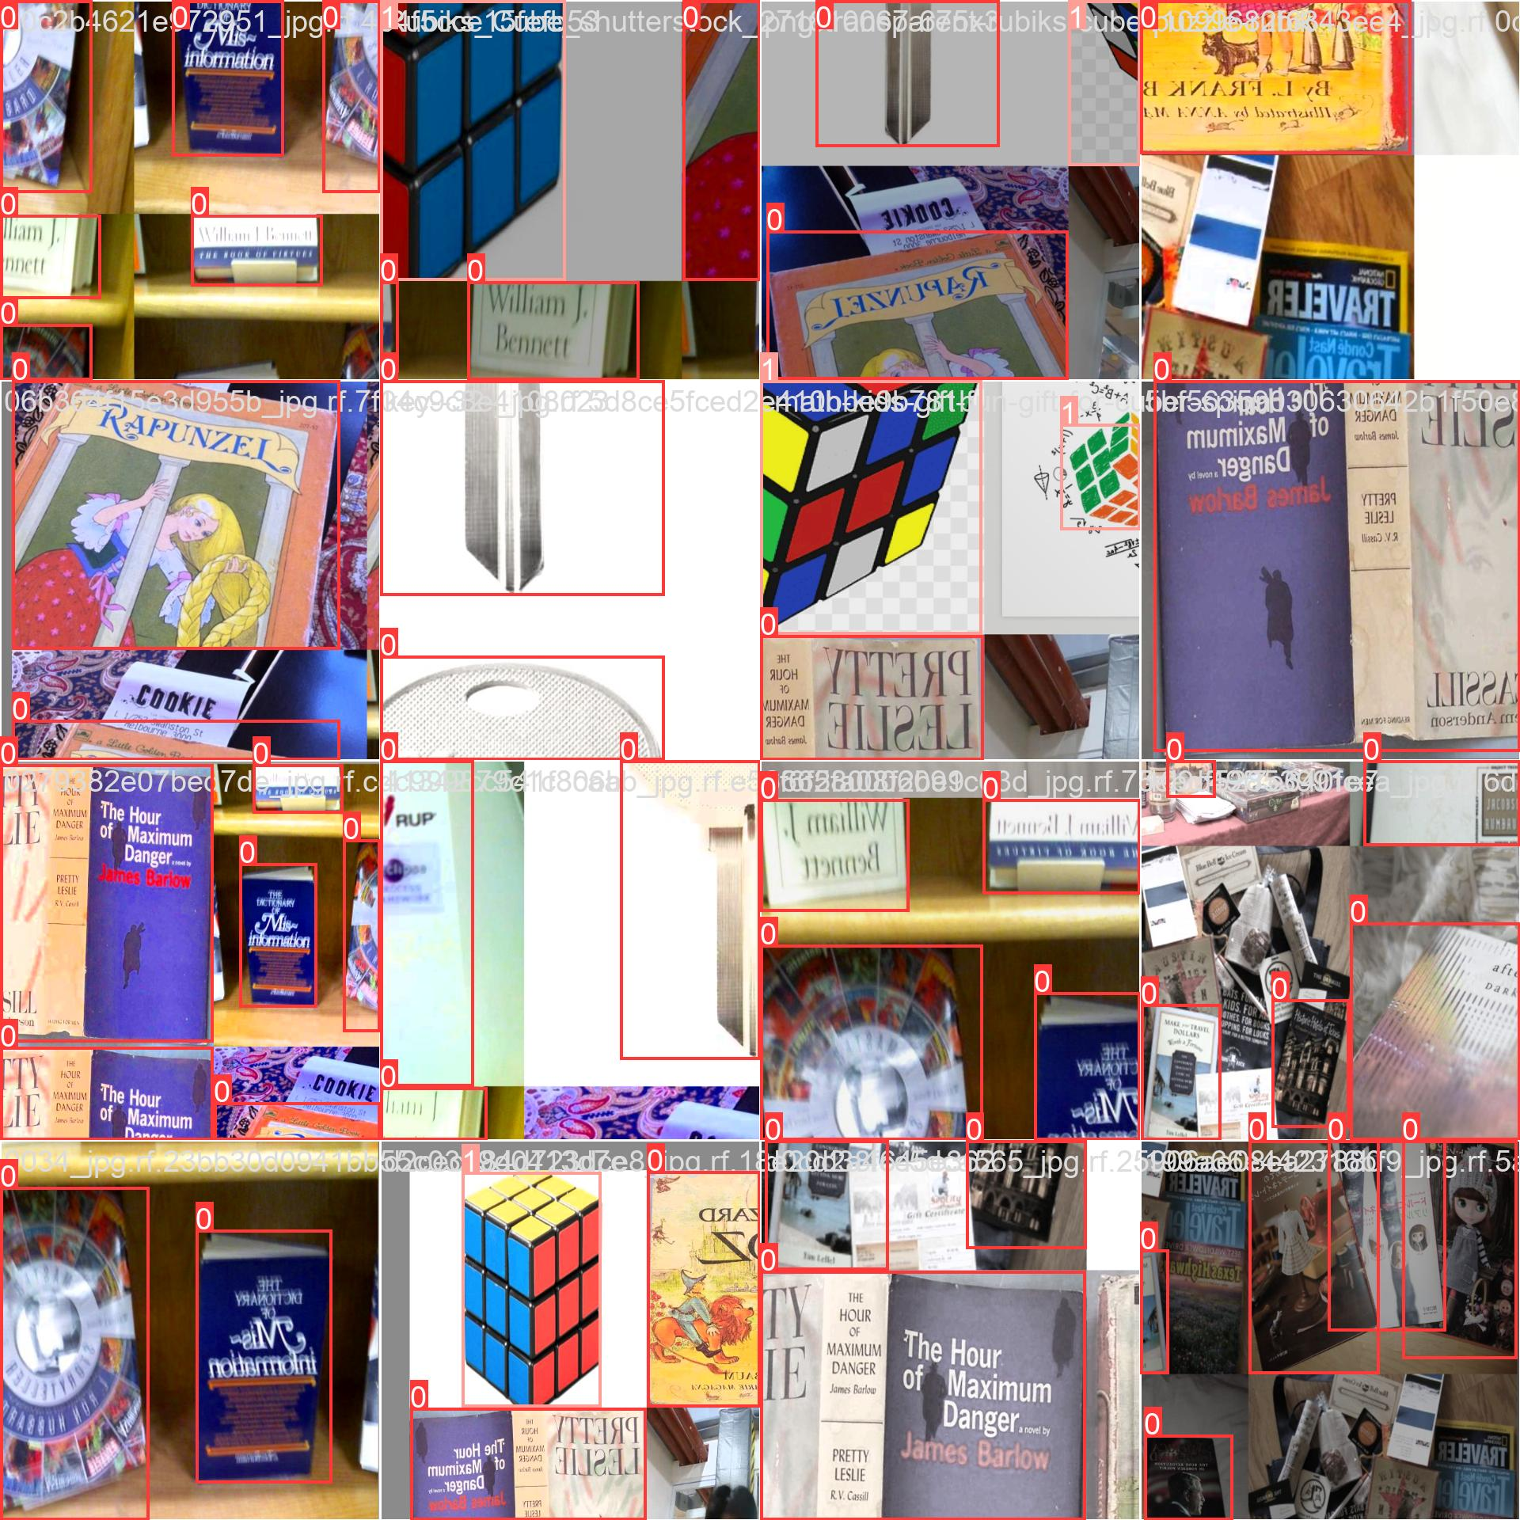
Training

Slide 18
GUI to demonstrate the accuracy
We design three kinds of GUI with different function:
Manually click photo detection one by one
Automatically detects all images in the directory
Real-time monitoring of photo streams

Slide 19
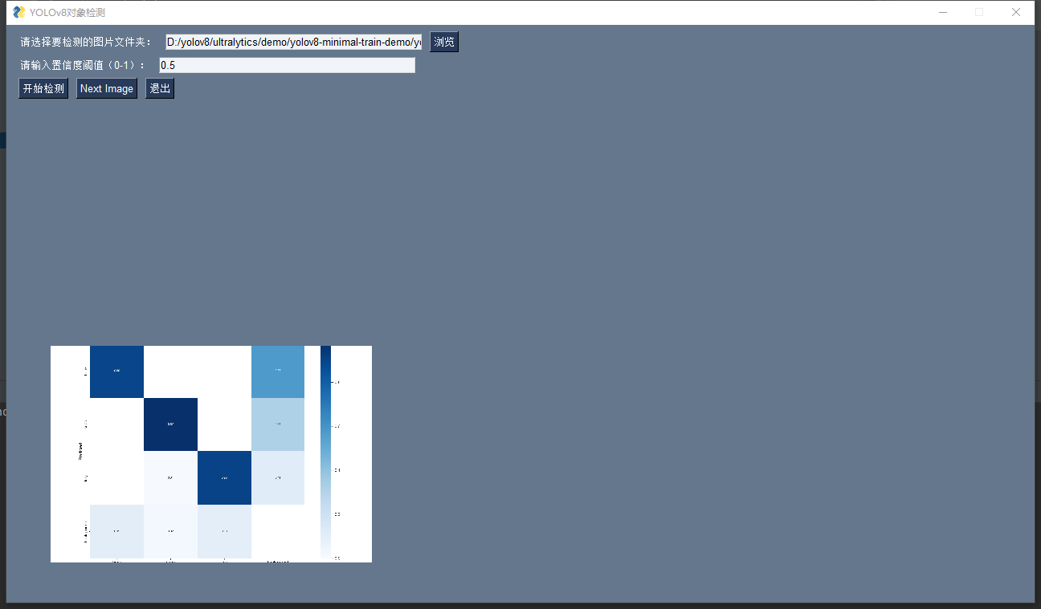
GUI

Slide 20
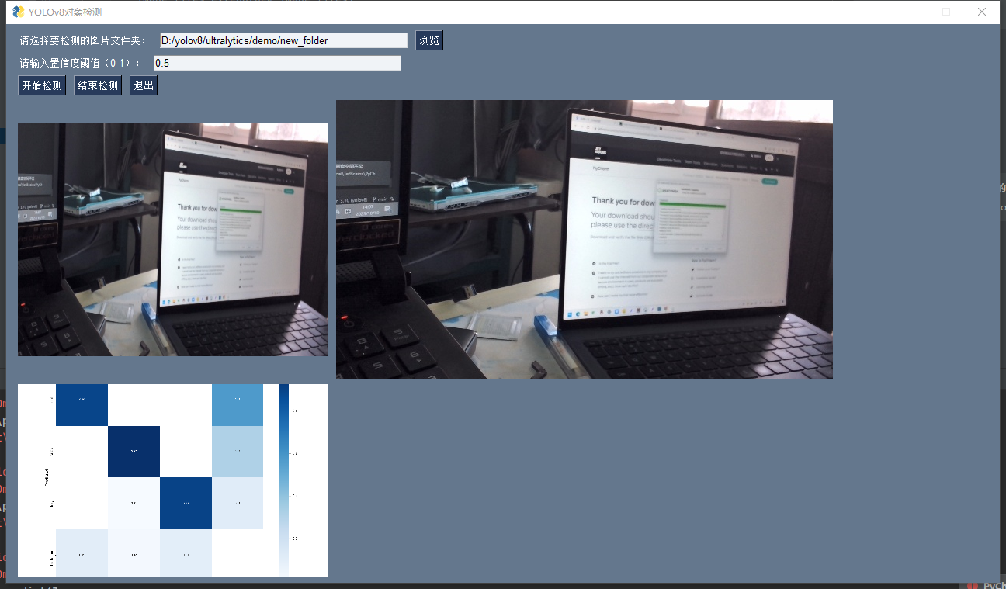
GUI

Slide 21
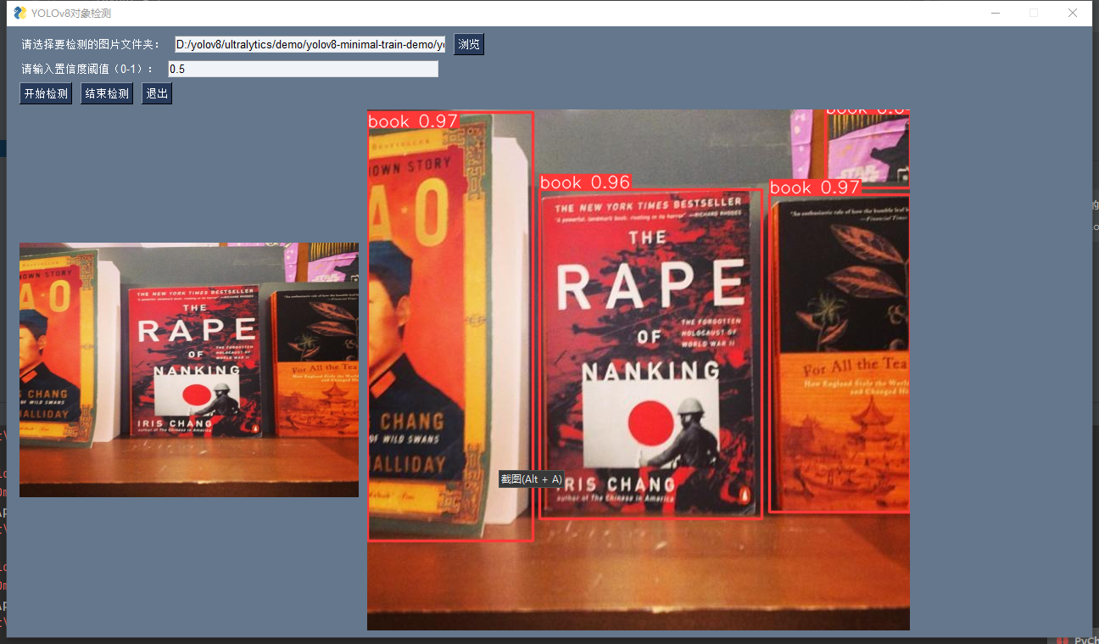
GUI

Slide 22
03
Database Management and Web Visualization

Slide 23
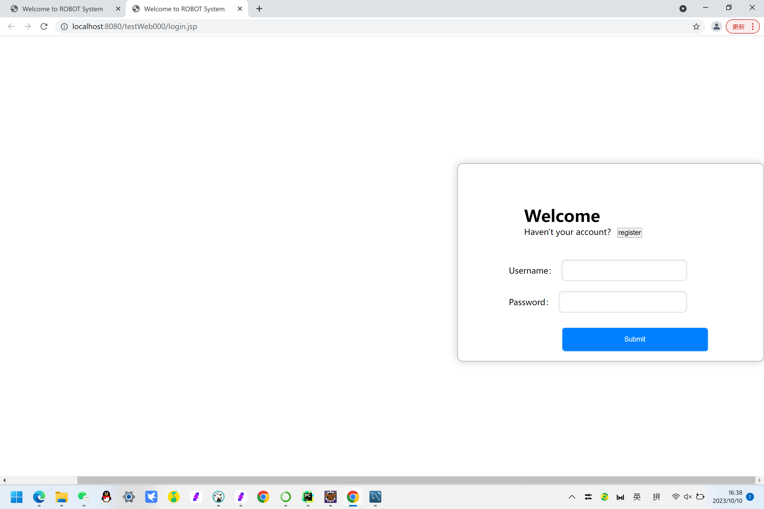
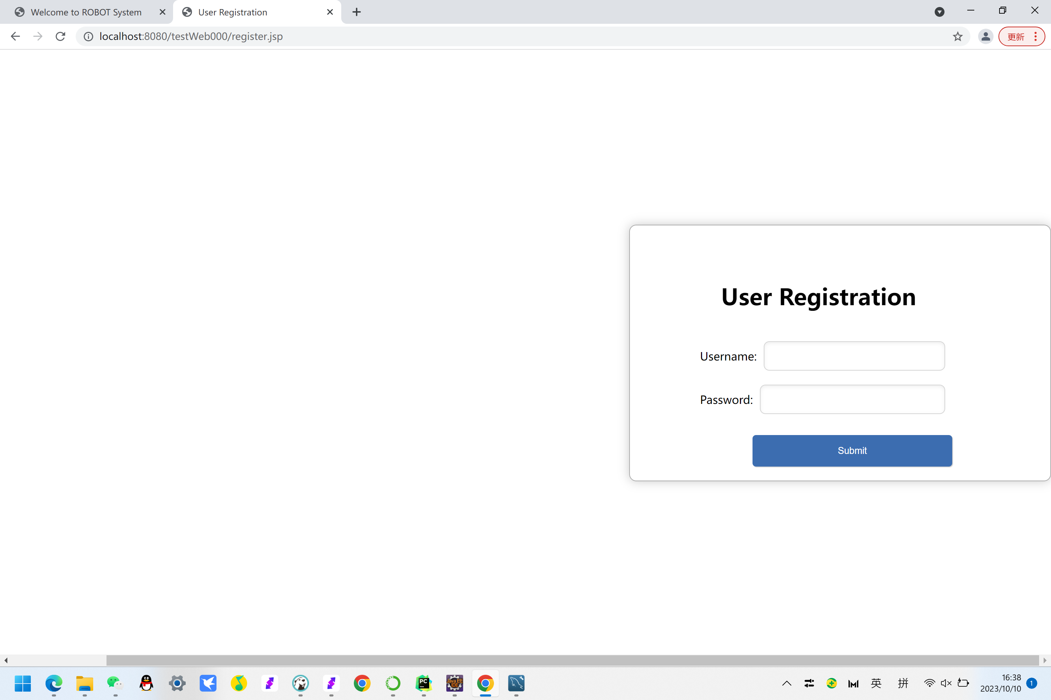
Web
E-Commerce student use the eclipse to create a web application which include login ,registered, and database visualization and other functions.
The left is the page of login and registered.

Slide 24
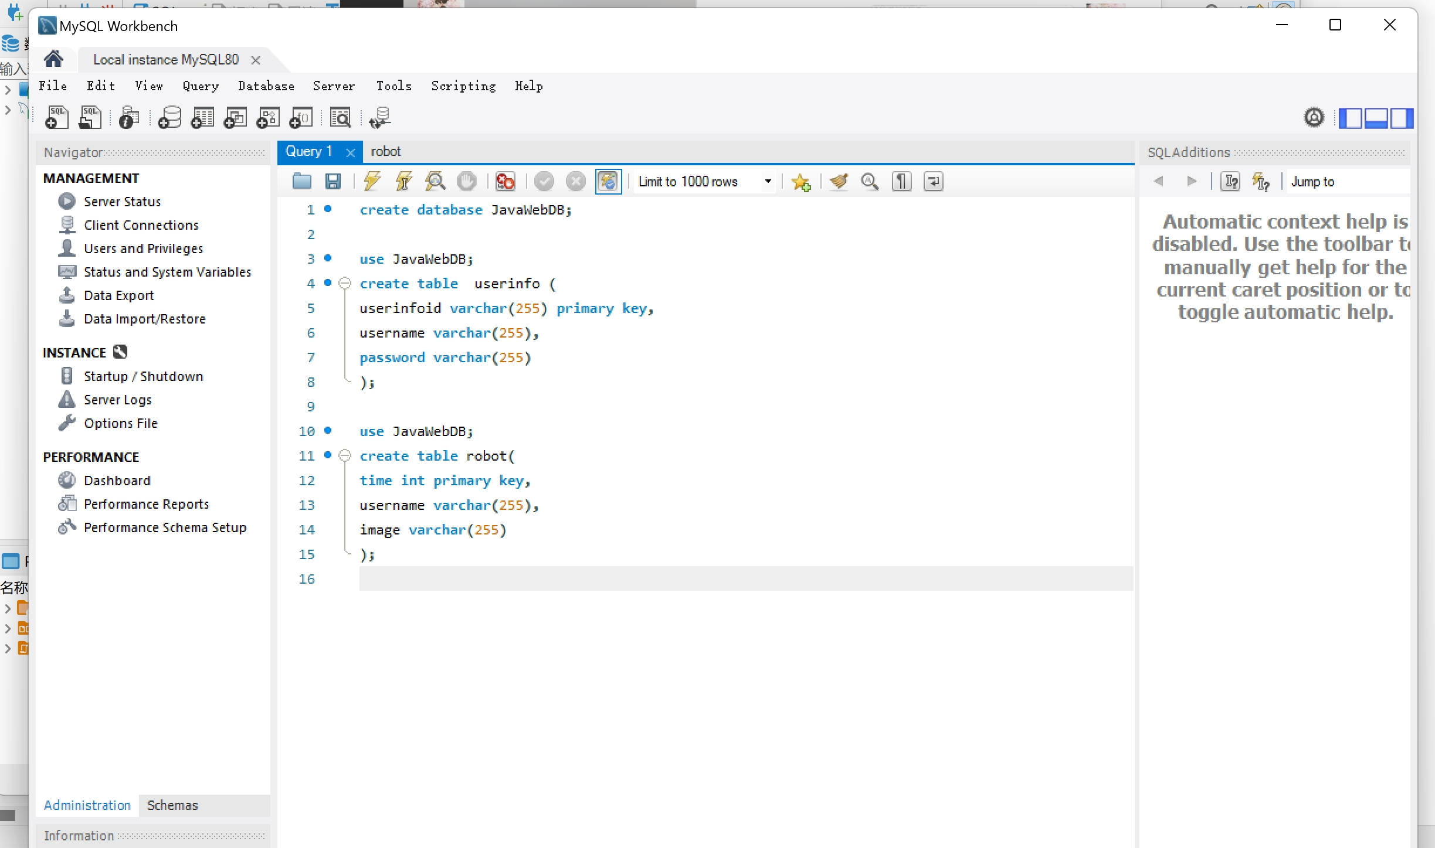
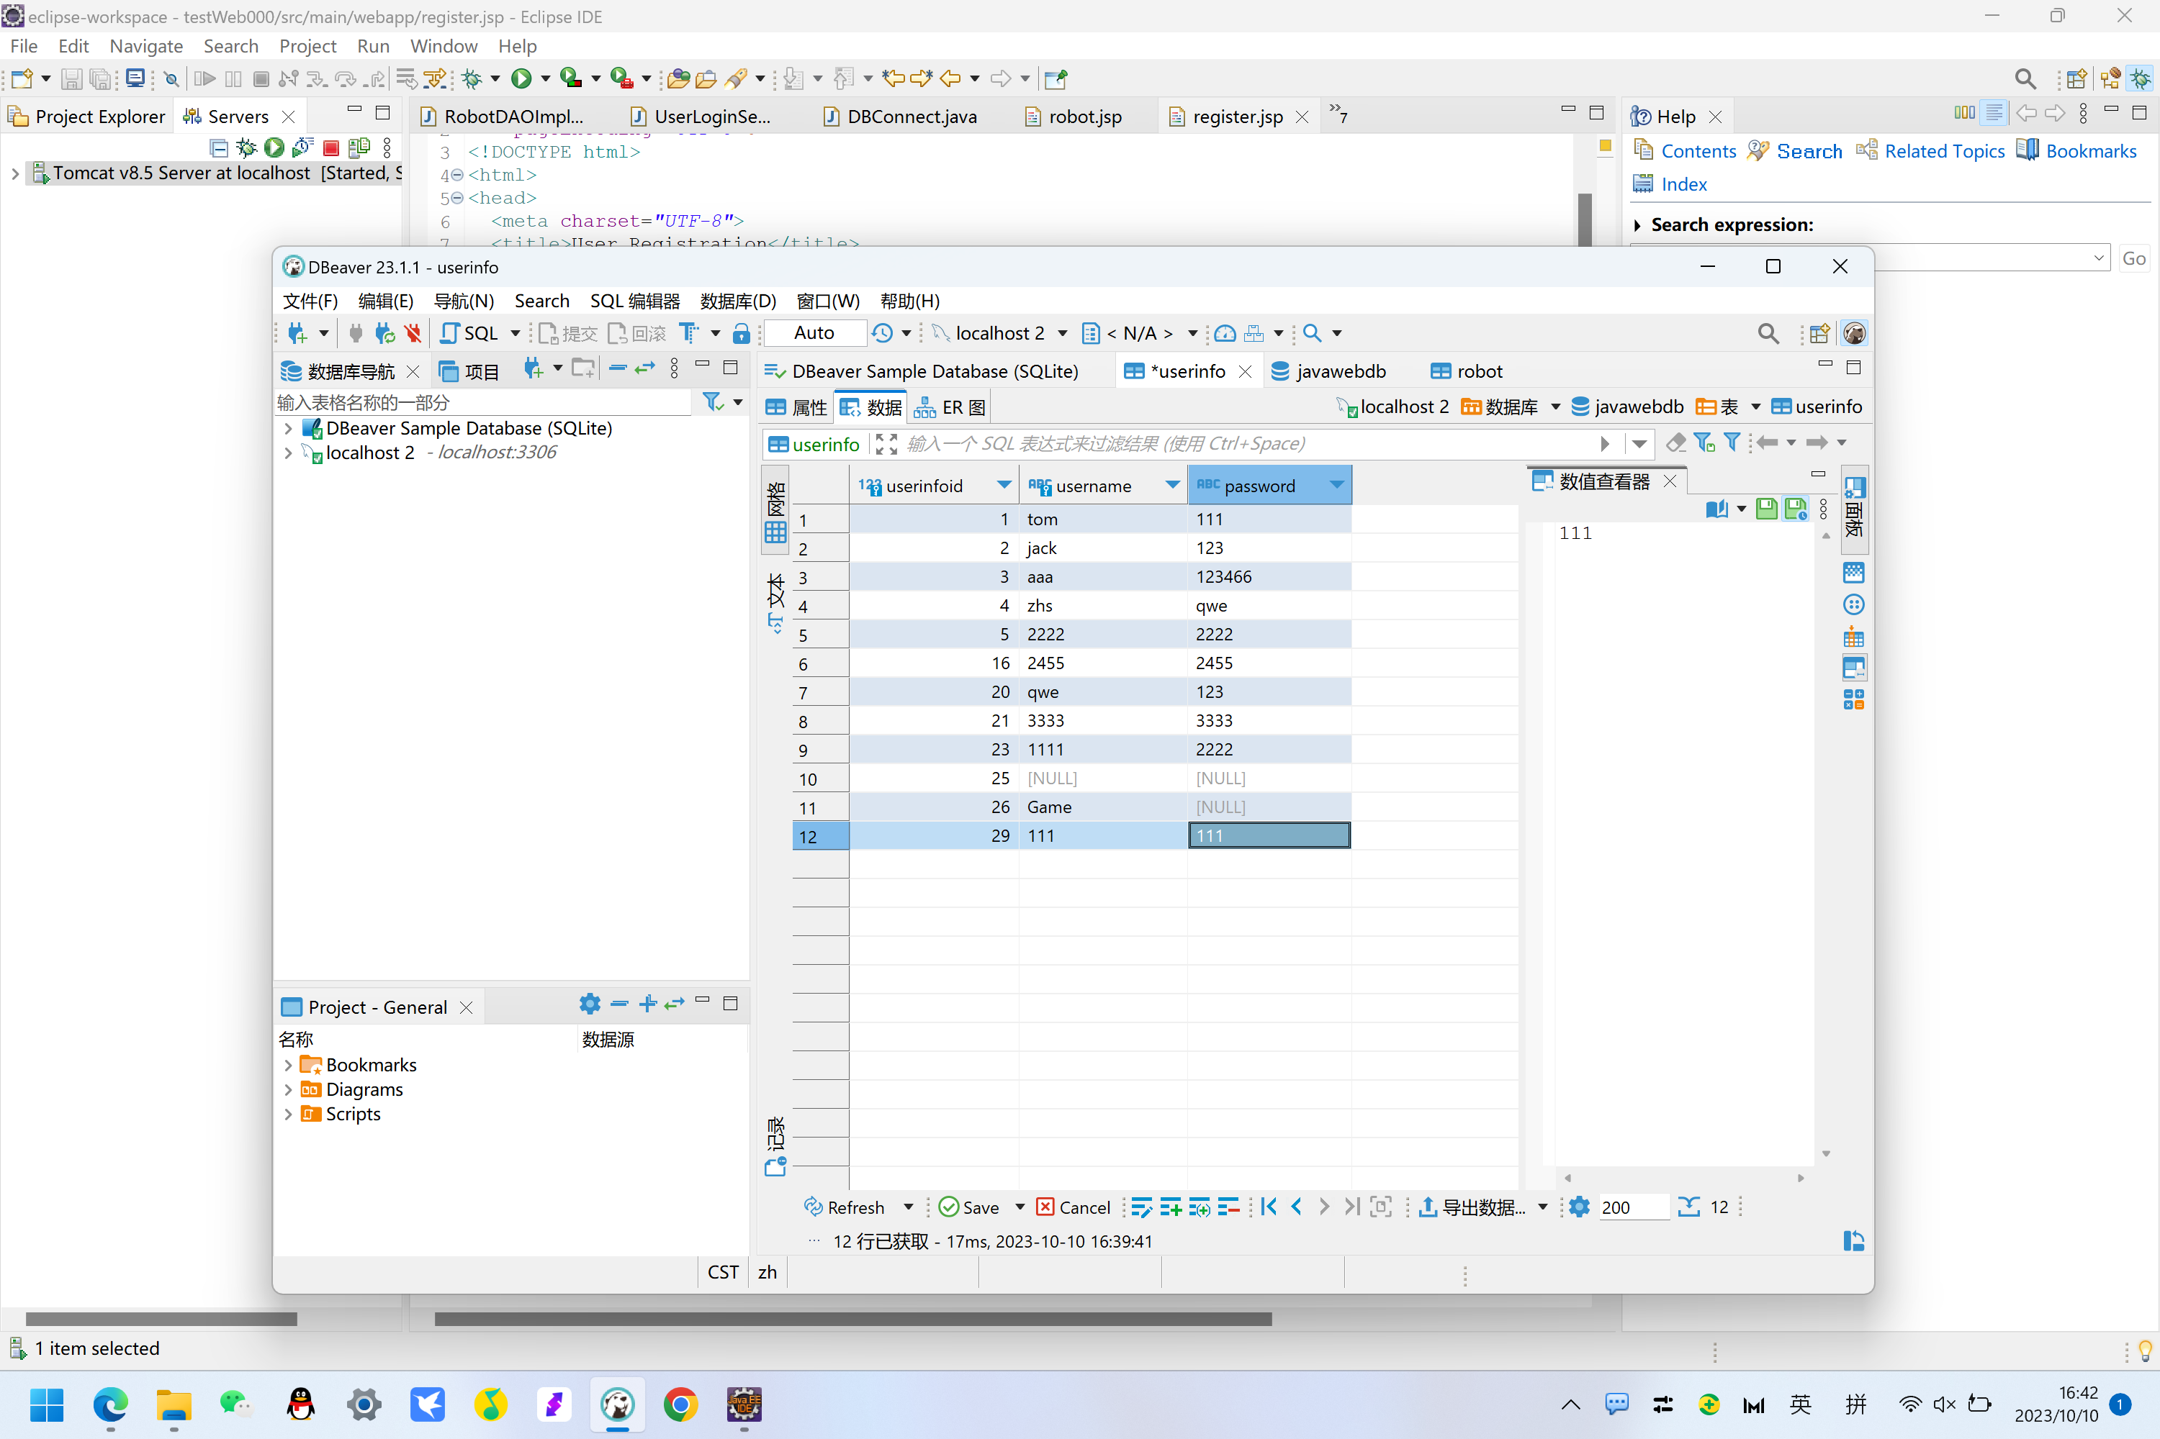
Database
The left is the database of our system

Slide 25
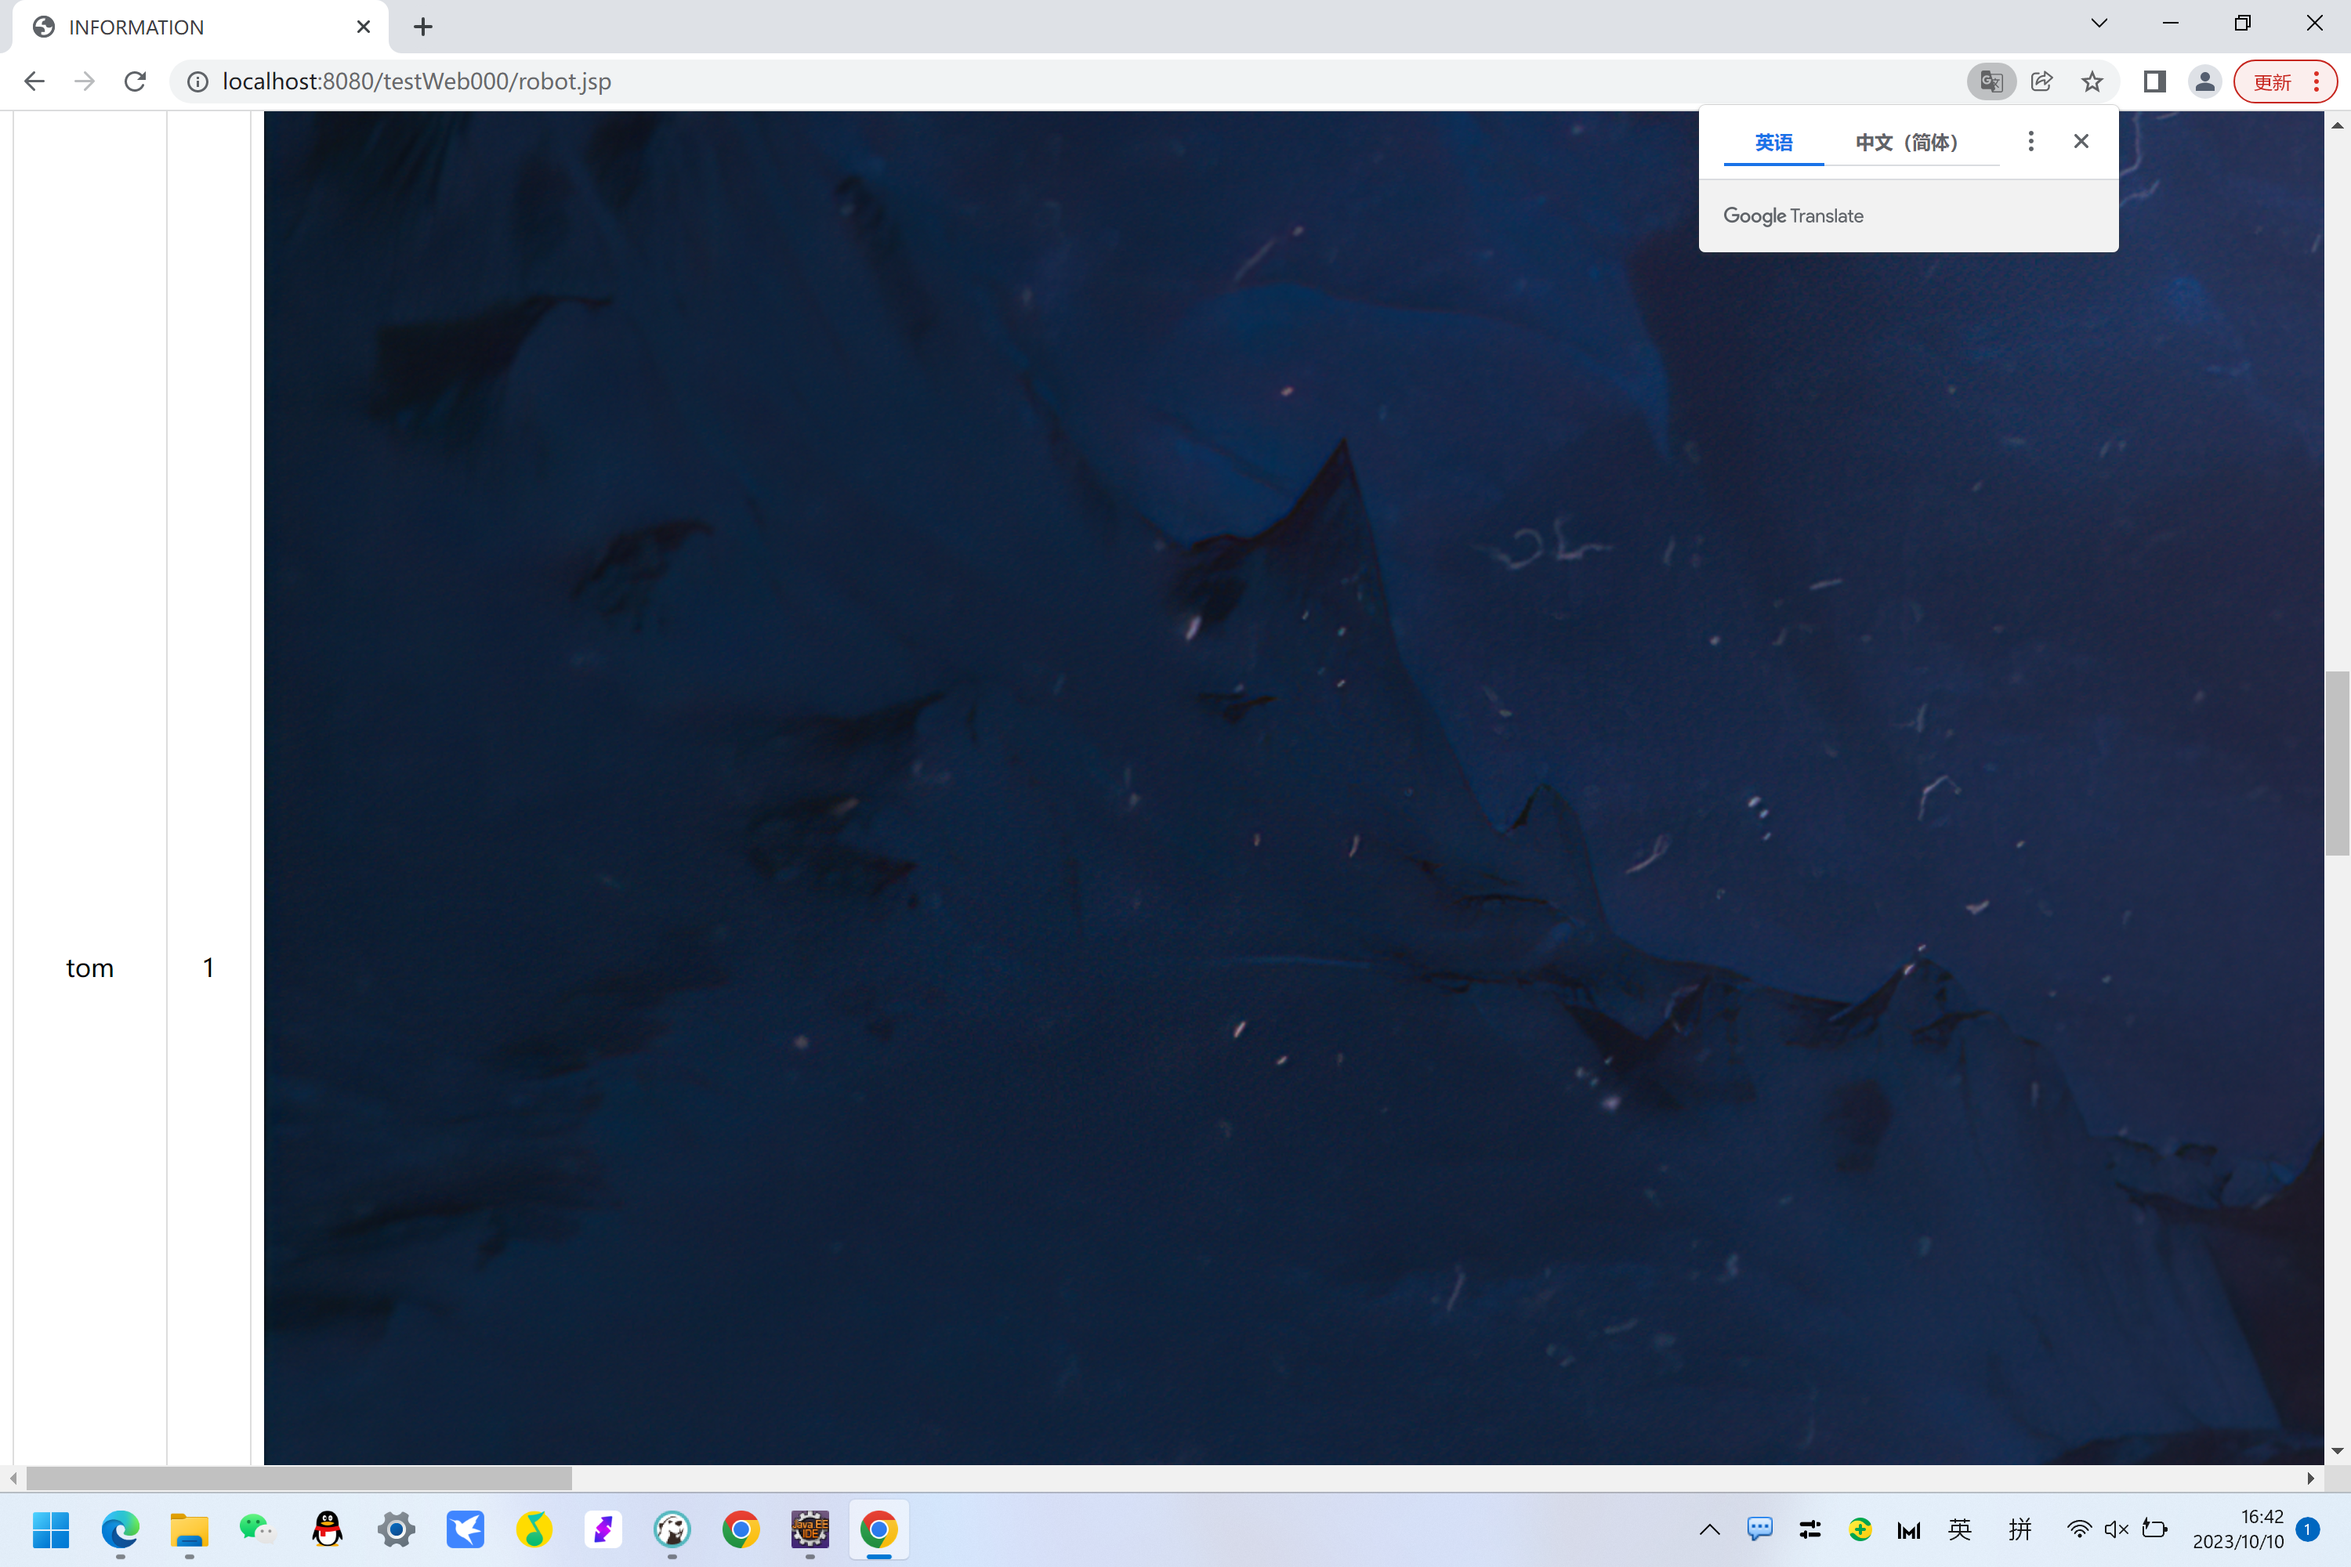
Web Visualisation
After we login in the system, it will show the username, robot id and the images

Slide 26
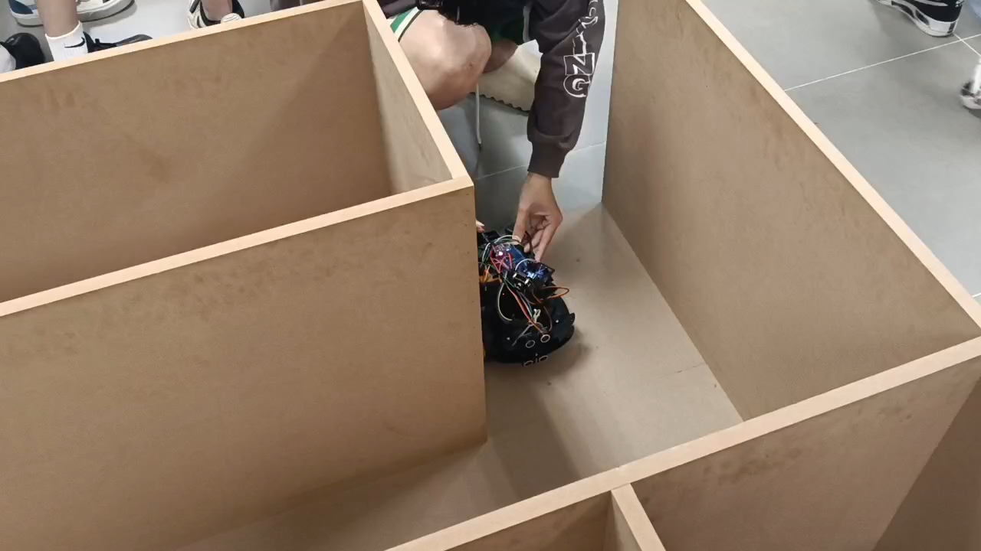
Demonstration

Slide 27
Contribution

Slide 28
Contribution ---TELE
Name | work | wontribution
Pei Yihao | The main tasks are assembling and assembling the car body, designing hardware and installation, debugging functions, etc. | 20%
Xiao Xinge | The main tasks are to write code logic and design the implementation methods of various functions, including traveling, obstacle avoidance, shooting and uploading, etc. | 20%
Ou Yuchen | Work together to write code logic and design implementation methods for various functions, including traveling, avoiding obstacles, shooting and uploading, etc. | 20%
Shao Yifei | The main tasks are assembling and assembling the car body, designing hardware and installation, debugging functions, etc. | 20%
Liang Jianwei | The main tasks are assembling and assembling the car body, designing hardware and installation, debugging functions, etc. | 20%

Slide 29
THE END
THANKS

